Slide 1
ELECTRONIC STORE
Supervised By
Dr.Sara Shehab
Eng.Gomaa Elmokhtar

Slide 2
LIGHT WAVE MEMBERS
Thnaa Rafat
Lamiaa Gadallah
Manar Abdelgwad
Eman Mohamed
Eman Samy

Slide 3
TABLE OF CONTENTS
01
02
03
04
Home page
Coming soon
Trending Products
Sign up form
Login form
Contact us form

Slide 4
INTRODUCTION
Websites that are for buying and selling products in general, not just electronic products, are a winning card in the world of remote shopping due to the time and effort available in dealing with such sites, which limit dealing directly with the seller or representative.

Slide 5
Front-End!
Focuses on layout, animations, content organization, navigation, graphics.
Programming languages: JavaScript, HTML, CSS

Slide 6
01
Home Page

Slide 7
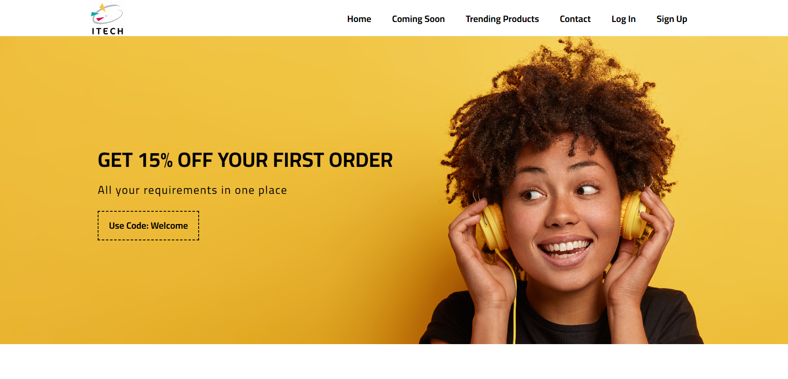

Slide 8
02
Coming soon
&
Trending Products

Slide 9
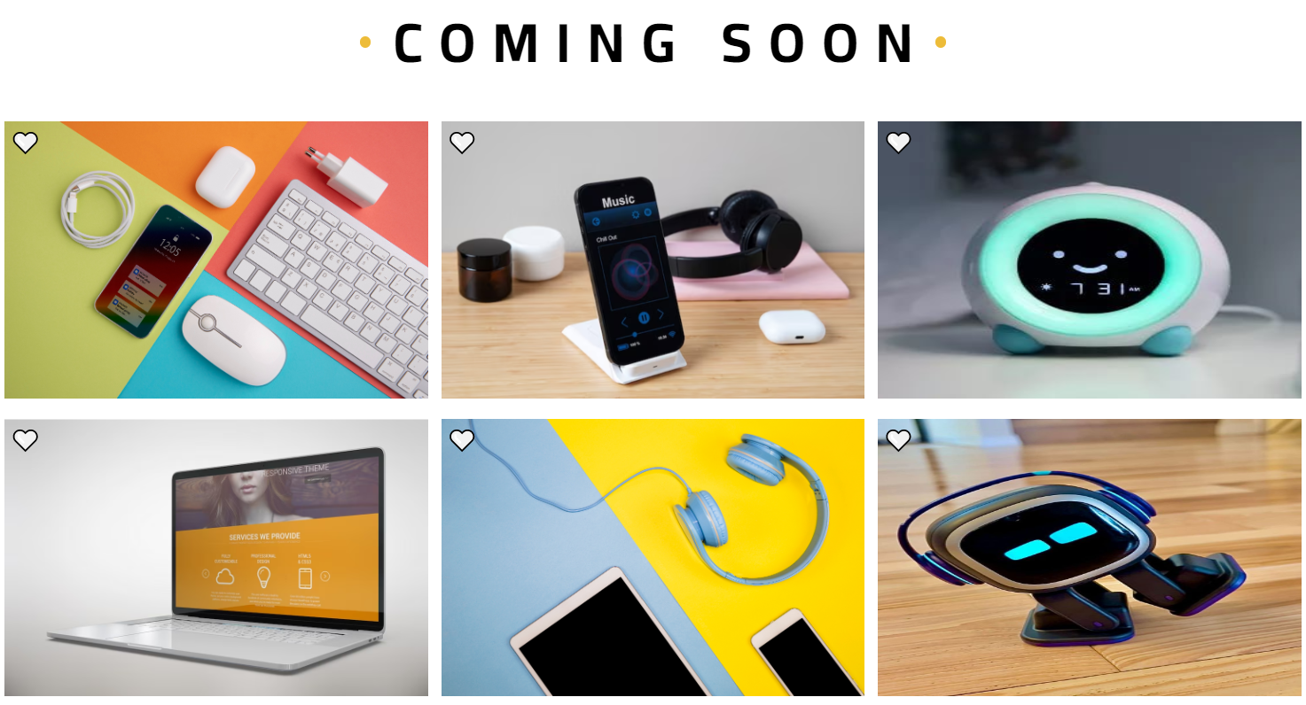

Slide 10
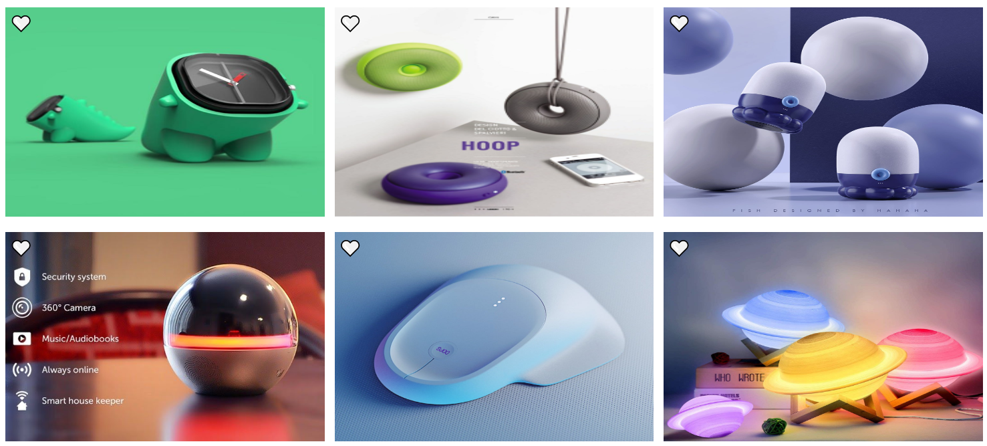

Slide 11
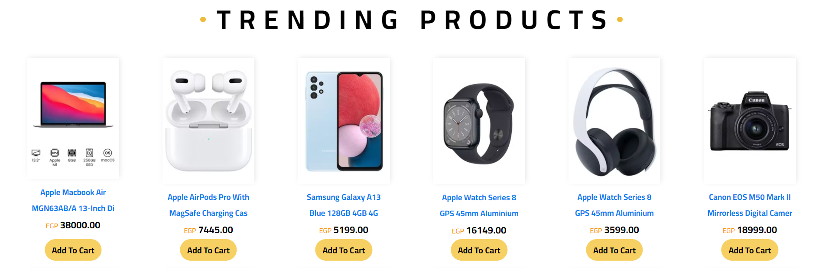
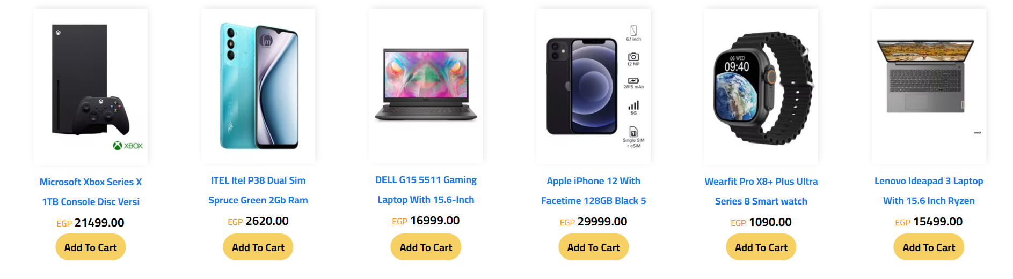

Slide 12
03
Sign Up
&
Login

Slide 13
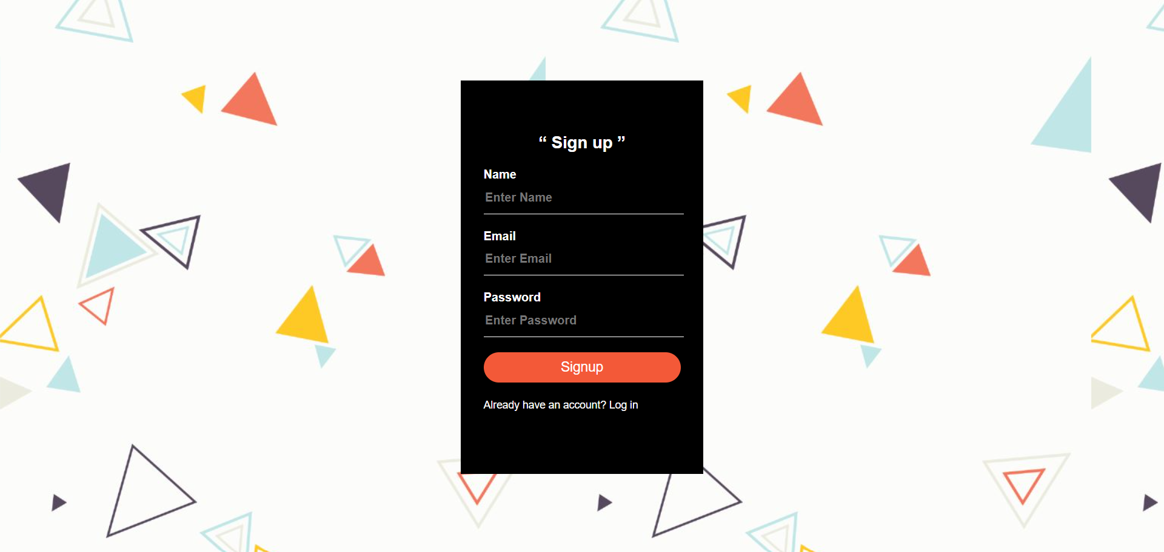

Slide 14
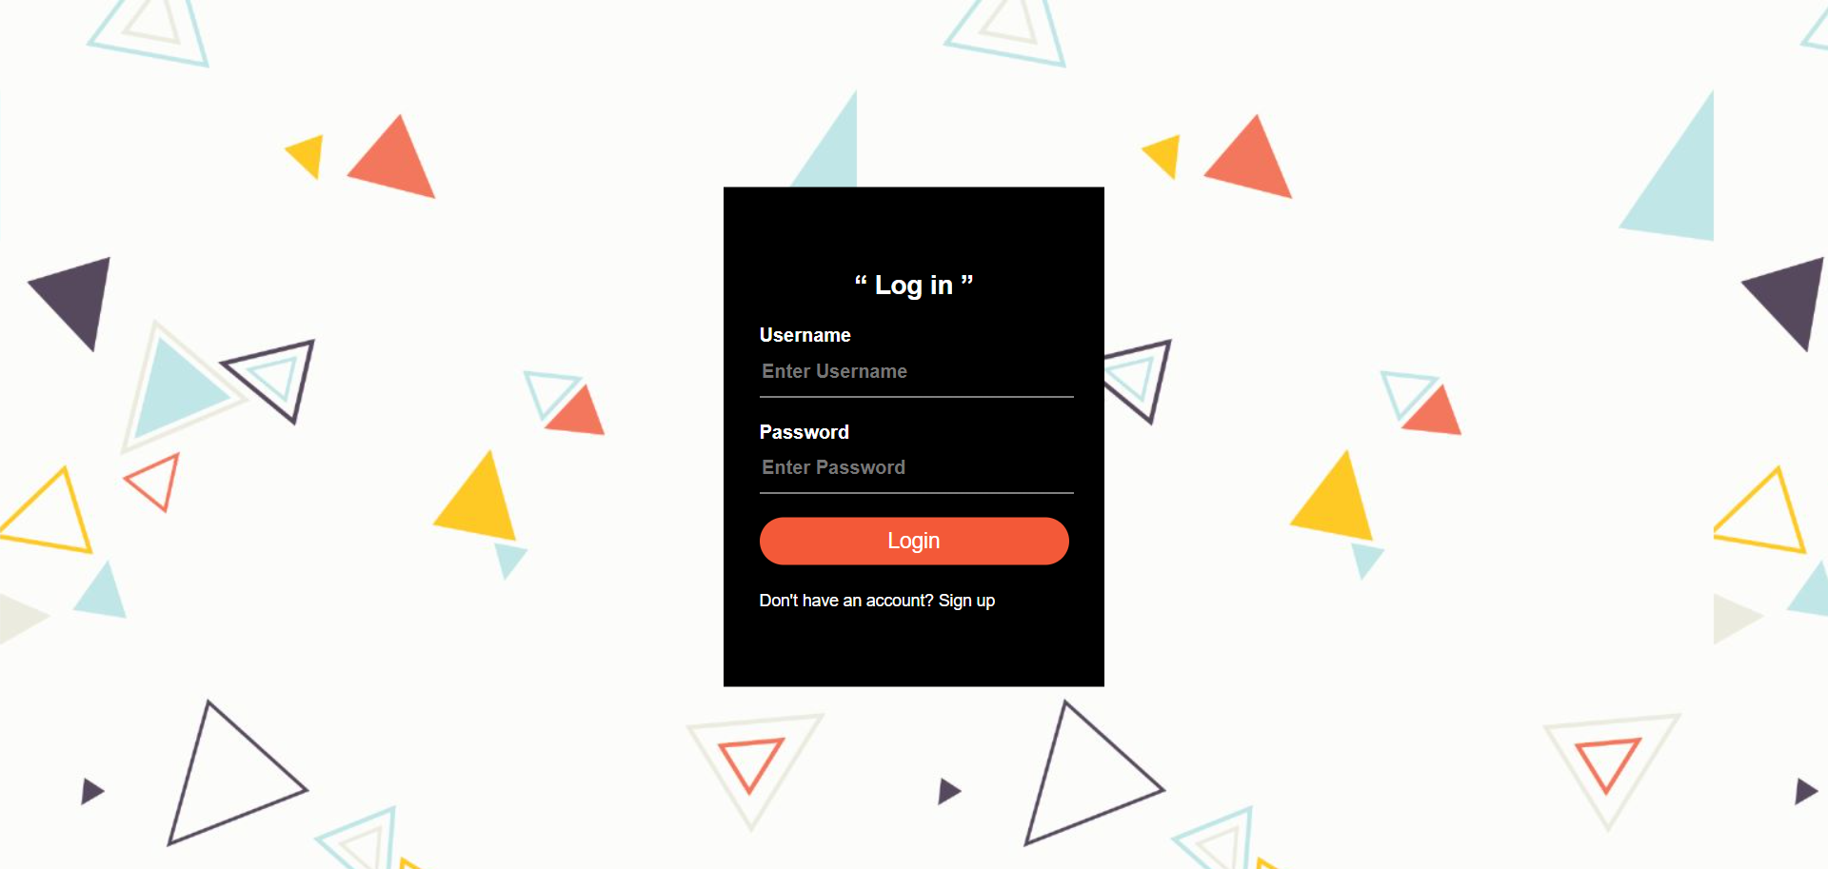

Slide 15
04
Contact Us

Slide 16
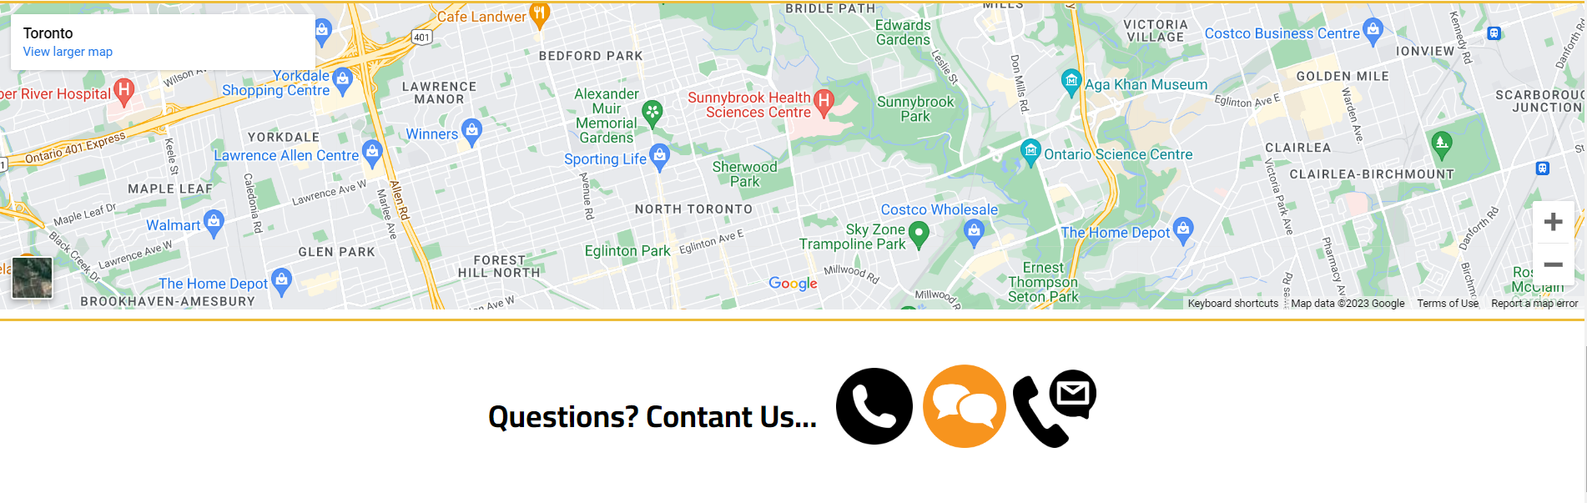

Slide 17
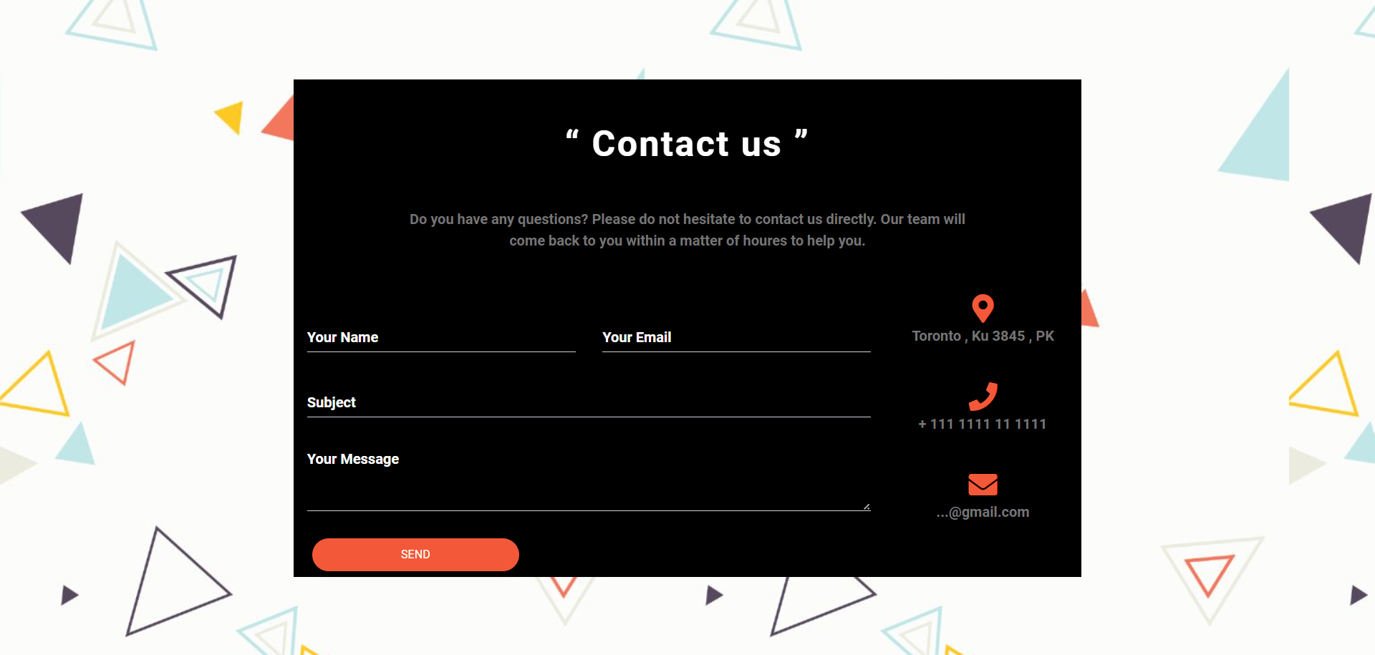

Slide 18
Back-End!
Focuses on building code, debugging, database management.
Programming languages: Node.js, Python, Java

Slide 19
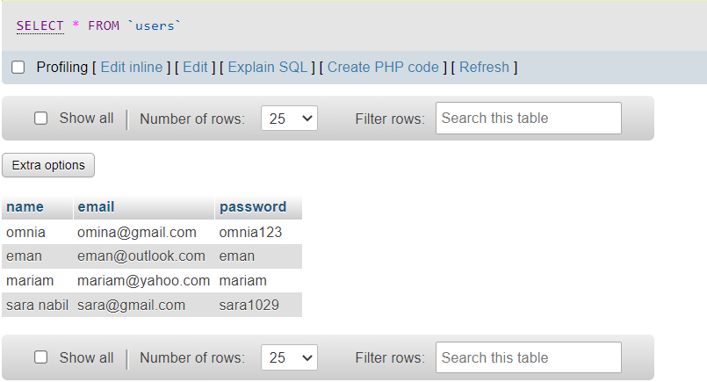

Slide 20
THANKS

